Slide 1

Object Tracking

Slide 2
Computer Vision with Python
Object Tracking Section Goals
Learn basic object tracking techniques
Optical Flow
MeanShift and CamShift
Understand more advanced tracking
Review Built-in Tracking APIs

Slide 3
Optical Flow

Slide 4
Computer Vision with Python
Let’s begin discussing object tracking by learning about optical flow.
Optical flow is the pattern of apparent motion of image objects between two consecutive frames caused by the movement of object or camera.

Slide 5
Computer Vision with Python
Optical Flow Analysis has a few assumptions:
The pixel intensities of an object do not change between consecutive frames.
Neighbouring pixels have similar motion.

Slide 6
Computer Vision with Python
The optical flow methods in OpenCV will first take in a given set of points and a frame.
Then it will attempt to find those points in the next frame.
It is up to the user to supply the points to track.

Slide 7
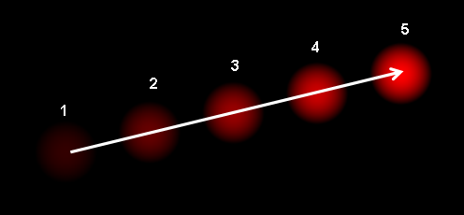
Computer Vision with Python
Consider the following image:

Slide 8
Computer Vision with Python
Here we display a five frame clip of a ball moving up and towards the right.

Slide 9
Computer Vision with Python
Note that given just this clip, we can not determine if the ball is moving, or if the camera moved down and to the left!

Slide 10
Computer Vision with Python
Using OpenCV we pass in the previous frame, previous points and the current frame to the Lucas-Kanade function.

Slide 11
Computer Vision with Python
Using OpenCV we pass in the previous frame, previous points and the current frame to the Lucas-Kanade function.

Slide 12
Computer Vision with Python
Using OpenCV we pass in the previous frame, previous points and the current frame to the Lucas-Kanade function.

Slide 13
Computer Vision with Python
The function then attempts to locate the points in the current frame.

Slide 14
Computer Vision with Python
The Lucas-Kanade computes optical flow for a sparse feature set.
Meaning only the points it was told to track.
But what if we wanted to track all the points in a video?

Slide 15
Computer Vision with Python
We can use Gunner Farneback’s algorithm (also built in to OpenCV) to calculate dense optical flow.
This dense optical flow will calculate flow for all points in an image.
It will color them black if no flow (no movement) is detected.

Slide 16
Computer Vision with Python
Check out the resource links for full descriptions and publication links for these two algorithms!
Note: Requires strong linear algebra skills to understand the math behind the methods.

Slide 17
Optical Flow with OpenCV
Part Two - Dense Optical Flow

Slide 18
Computer Vision with Python
Currently we have a flow object containing vector flow cartesian information:
y
X

Slide 19
Computer Vision with Python
We want to convert this into polar coordinates to magnitude and angle.
mag
ang

Slide 20
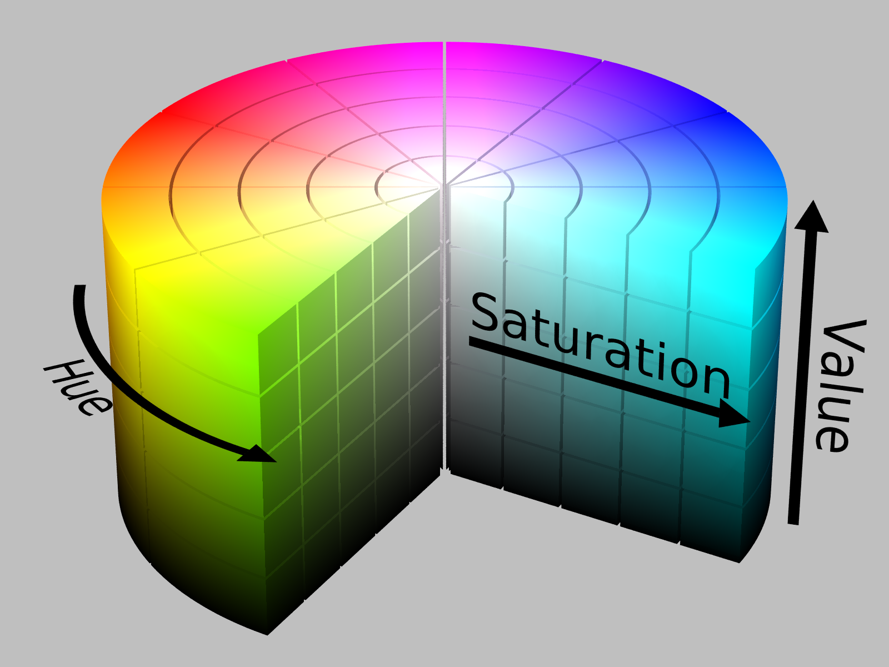
Computer Vision with Python
We want to convert this into polar coordinates to magnitude and angle.
mag
ang

Slide 21
Computer Vision with Python
Currently we have a flow object containing vector flow information:
mag
mag
ang
ang

Slide 22
MeanShift and CamShift Tracking
OpenCV Implementation

Slide 23
Computer Vision with Python
Some of the most basic tracking methods are MeanShift and CAMShift.
Let’s first describe the general MeanShift algorithm, then learn how to apply it for image tracking.
Afterwards we will learn how to extend the MeanShift into CAMShift (Continuously Adaptive MeanShift)

Slide 24
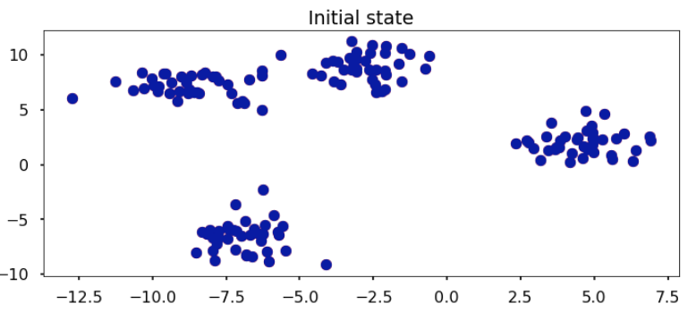
Computer Vision with Python
Imagine we have a set of points and we wanted to assign them into clusters.

Slide 25
Computer Vision with Python
We take all our data points and stack red and blue points on them. (You can’t see the red points underneath)

Slide 26
Computer Vision with Python
The direction to the closest cluster centroid is determined by where most of the points nearby are at.

Slide 27
Computer Vision with Python
So each iteration each blue point will move closer to where the most points are at, which is or will lead to the cluster center.

Slide 28
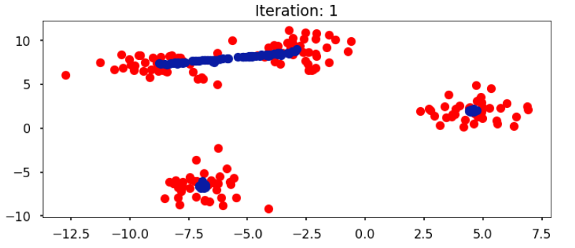
Computer Vision with Python
The red and blue datapoints overlap completely in the first iteration before the Meanshift algorithm starts.

Slide 29
Computer Vision with Python
At the end of iteration 1, all the blue points move towards the clusters. Here is appears there will be either 3 or 4 clusters

Slide 30
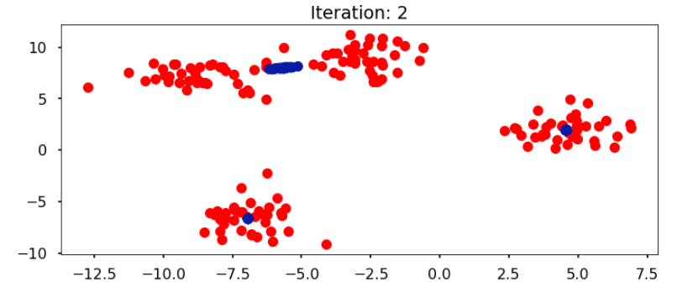
Computer Vision with Python
The bottom clusters have begun to reach convergence.

Slide 31
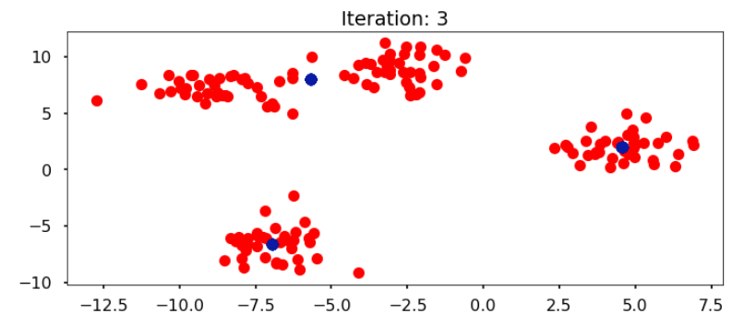
Computer Vision with Python
MeanShift found 3 clusters by the third iteration .

Slide 32
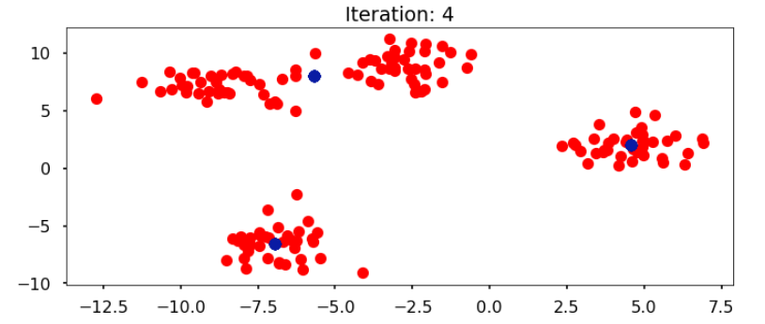
Computer Vision with Python
After subsequent iterations, the cluster means have stopped moving.

Slide 33
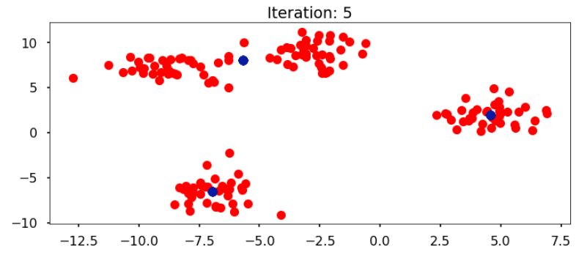
Computer Vision with Python
All clusters have converged and there is no more movement.

Slide 34
Computer Vision with Python
Identified Clusters:

Slide 35
Computer Vision with Python
It won’t always detect what may be more “reasonable”.
It may have been more reasonable to detect 4 clusters in the previous situation.

Slide 36
Computer Vision with Python
MeanShift can be given a target to track, calculate the color histogram of the target area, and then keep sliding the tracking window to the closest match (the cluster center).
Let’s view an animation on this.

Slide 37
Computer Vision with Python
MeanShift Tracking

Slide 38
Computer Vision with Python
Just using MeanShift won’t change the window size if the target moves away or towards the camera.
We can use CAMshift to update the size of the window.
Let’s take a look.

Slide 39
Computer Vision with Python
CAMShift Tracking

Slide 40
Computer Vision with Python
Let’s explore this with OpenCV!

Slide 41
CamShift Tracking

Slide 42
Computer Vision with Python
Course Overview Lecture
Useful tips for going through the course
How to get help during the course
Advice on how to approach the course
Where to find the course notebooks
How to use the student chat channel

Slide 43
Tracking APIs
with OpenCV

Slide 44
Computer Vision with Python
There are many Object Tracking methods.
Fortunately, many have been designed as simple API calls with OpenCV.
Let’s explore a few of these easy to use Object Tracking APIs and in the next lecture we will show you how to explore them with OpenCV!

Slide 45
Computer Vision with Python
BOOSTING TRACKER
Based off AdaBoost algorithm (the same underlying algorithm that the HAAR Cascade based Face Detector Used).
Evaluation occurs across multiple frames.

Slide 46
Computer Vision with Python
BOOSTING TRACKER
Pros:
Very well known and studied algorithm.
Cons:
Doesn’t know when tracking has failed.
Much better techniques available!

Slide 47
Computer Vision with Python
MIL TRACKER
Multiple Instance Learning
Similar to BOOSTING, but considers a neighborhood of points around the current location to create multiple instances.
Check project page for more details.

Slide 48
Computer Vision with Python
MIL TRACKER
Pros:
Good performance and doesn’t drift as much as BOOSTING.
Cons:
Failure to track an object may not be reported back.
Can’t recover from full obstruction.

Slide 49
Computer Vision with Python
KCF TRACKER
Kernelized Correlation Filters
Exploits some properties of the MIL Tracker and the fact that many data points will overlap, leading to more accurate and faster tracking.

Slide 50
Computer Vision with Python
KCF TRACKER
Pros:
Better than MIL and BOOSTING.
Great first choice!
Cons:
Can not recover from full obstruction of object.

Slide 51
Computer Vision with Python
TLD TRACKER
Tracking, Learning, and Detection
The tracker follows the object from frame to frame.
The detector localizes all appearances that have been observed so far and corrects the tracker if necessary.

Slide 52
Computer Vision with Python
TLD TRACKER
Tracking, Learning, and Detection
The learning estimates detector’s errors and updates it to avoid these errors in the future.

Slide 53
Computer Vision with Python
TLD TRACKER
Pros:
Good at tracking even with obstruction in frames.
Tracks well under large changes in scale.
Cons:
Can provide many false positives.

Slide 54
Computer Vision with Python
MedianFlow TRACKER
Internally, this tracker tracks the object in both forward and backward directions in time and measures the discrepancies between these two trajectories.

Slide 55
Computer Vision with Python
MedianFlow TRACKER
Pros:
Very good at reporting failed tracking.
Works well with predictable motion.
Cons:
Fails under large motion (fast moving objects)

Slide 56
Computer Vision with Python
Let’s check out how to use these tracking APIs with OpenCV and Python!
Also check out the resource links for more detailed information on each of these trackers!

